Slide 1
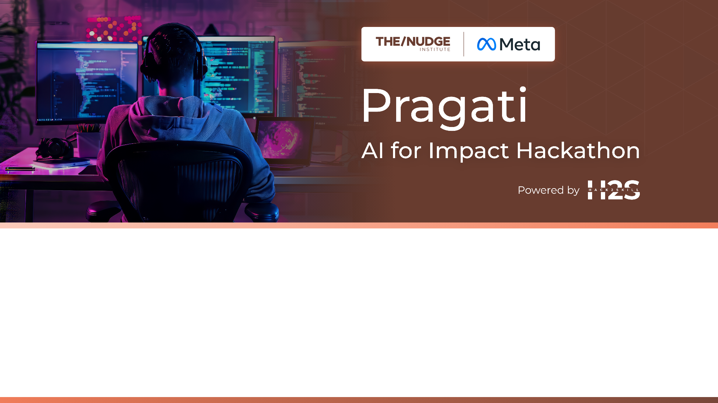
Team Name : TEAM NEXUS
Team Leader Name : EDWIN VIJU
Which domain does your idea address : AGRICULTURE

Slide 2

What is the problem you are solving? (50 words max)
We are solving the problem of price transparency and market access for farmers by creating an app that connects them with traders.
Using AI tools, we address disputes from unclear quality standards and equip farmers and traders with simple, accurate ways to assess spice quality before trade—ensuring fair pricing and trust.

Slide 3
Describe your solution. How different is it from any of the other existing ideas? How will it be able to solve the problem? USP of the proposed solution? What is the intended impact of your solution (max 350 words).
Our proposed solution is a mobile application designed to bridge the gap between farmers and traders by providing real-time price updates, shop locations, and quality-based pricing for spices. The app will have two main user logins:
Traders (Shop Owners): Traders can register their shops, update daily prices and available stock, and categorize products into High, Average, and Low Quality.
Farmers (Customers): Farmers can log in with their details and location, compare prices from nearby traders or specific locations, select product quality, and book slots for selling their produce.
Additionally, an AI-based quality detection feature will help assess the quality of spices, ensuring fair pricing.
Differentiation from Existing Solutions
Unlike other platforms that only provide market prices, our app connects farmers directly with registered traders for real-time price negotiation.
The quality-based pricing feature allows traders to set prices based on produce quality, giving farmers better options.
The AI-driven quality detection tool provides objective quality assessments, reducing disputes and ensuring transparency.
Farmers can pre-book slots for selling their spices, optimizing their sales and reducing wastage.

Slide 4
How It Solves the Problem
Price Transparency: Farmers can see daily price variations across multiple shops, preventing them from being exploited by middlemen.
Market Access: Direct connectivity between farmers and traders increases fair trade opportunities.
Better Planning: Traders can update the quantity they need, helping farmers plan their sales efficiently.
Quality Assurance: AI-powered quality checks promote fair pricing and reduce uncertainty in trade.
Unique Selling Proposition (USP)
Real-time price updates from multiple traders instead of just government or market rates.
AI-driven quality detection to ensure objective pricing.
Location-based shop listings and pre-booking feature to streamline transactions.
Intended Impact
This solution aims to empower farmers with accurate market information, increase fair trade opportunities, and enhance efficiency in agricultural commerce. By reducing middlemen exploitation and improving pricing transparency, it will lead to better earnings for farmers and more efficient procurement for traders, ultimately benefiting the entire agricultural supply chain.

Slide 5
Who is the primary user of your solution, and explain how your solution will leverage open-source AI to address the aspects mentioned in the Key Design Guidelines (max 200 words).
Primary User:
The primary users of our solution are farmers and traders in the agricultural sector. Farmers benefit from real-time price updates, direct market access, and AI-based quality detection, while traders gain improved procurement efficiency and better-quality assessments.
Leveraging Open-Source AI to Address Key Guidelines:
1.Technical Realities:
Use lightweight AI models optimized for low-bandwidth conditions.
People with low network connectivity can get access to this application.

Slide 6
2. User context
Use explainable AI (XAI) to build trust by showing how pricing and quality assessments are determined.
Provide a voice-assisted interface in regional languages to support low digital literacy.
3. Resource Limitations:
Use open-source AI models (e.g., TensorFlow Lite) to reduce costs.
Implement transfer learning to compensate for sparse training data.
Partner with local agricultural experts to refine AI predictions.
4. Ethical Considerations:
Ensure data privacy by encrypting user information.
Regularly audit AI algorithms to mitigate bias.
Promote community-driven AI development for long-term sustainability.
By integrating open-source AI, our solution remains cost-effective, accessible, and scalable, catering to real-world farming challenges

Slide 7
How is this solution scalable? (100 words max)
Our solution is highly scalable due to its modular AI architecture, cloud-based data processing, and multi-platform accessibility. Using open-source AI models, we can continuously improve quality detection without high costs. The location-based shop listing and price updates dynamically adapt as more traders join.
To expand, we can integrate more products, markets, and languages while leveraging federated learning to improve AI accuracy without centralizing data. Partnerships with agricultural cooperatives and government programs will further drive adoption. This low-cost, AI-powered model ensures seamless expansion across regions with varying infrastructure.
Furthermore, integrating open-source AI keeps costs low while enabling continuous development and customization. Through local partnerships and community-driven AI improvements, the solution can evolve based on real-world needs, making it a cost-effective, adaptable, and globally scalable platform for transforming agricultural trade.

Slide 8
List of features offered by the solution
Real-Time Price Updates – Farmers can compare prices from multiple traders to ensure fair deals.
AI-Driven Quality Detection – Uses AI to assess spice quality for objective pricing.
Direct Farmer-Trader Connectivity – Farmers can negotiate directly with traders, bypassing middlemen.
Location-Based Shop Listings – Traders' shops are listed based on proximity for easy access.
Pre-Booking Slots – Farmers can schedule sales to optimize market timing and reduce wastage.
Language Support – Regional language integration to ensure usability across diverse communities.
Offline Functionality – Enables key features in areas with poor connectivity.
AI-Powered Trade Recommendations – Suggests best times and places to sell based on market trends.
Secure Transactions & Data Privacy – Encrypts user data and ensures transparency in AI decision-making.

Slide 9
What open-source AI tools and technologies will you use to design the solution? (Please list all.)
TensorFlow Lite
Teachable Machine
OpenCV
Flutter
Firebase ML Kit
Firebase Firestore
Firebase Authentication
OpenStreetMap
Leaflet.js

Slide 10
Why are these open-source technologies the most appropriate for your solution? (150 words max)
These open-source technologies are the most appropriate for our solution as they are cost-effective, lightweight, and optimized for mobile use, addressing technical realities such as unreliable internet and basic smartphones.
TensorFlow Lite ensures AI models run smoothly on low-power devices, making them suitable for rural farmers. Teachable Machine simplifies model training, eliminating the need for deep technical expertise.
OpenCV allows real-time image processing, helping detect spice quality (colour, size, shape, texture) with minimal computational power. Flutter enables a user-friendly mobile app supporting regional languages, improving accessibility for farmers with limited digital literacy.
These tools also address ethical considerations, ensuring transparency in AI predictions while enabling sustainable, community-driven development. By using open-source AI, we reduce costs, enhance scalability, and provide a trustworthy, locally adaptable solution that empowers both farmers and traders in the agricultural ecosystem.

Slide 11
Describe the Solutions Architecture (500 words)
Our solution is a mobile application that bridges the gap between farmers and traders by enabling real-time communication, price transparency, and efficient market access. The app features two types of user logins: one for farmers and one for traders (shop owners). Farmers can view real-time updates on spices prices, locate nearby traders, and receive alerts on price changes. Traders, on the other hand, can register their shop, update available stock, and set prices based on quality and demand.
The app uses a centralized backend to store user data, pricing info, and trade history. It interacts with the frontend (mobile app) using APIs for real-time data exchange. The app can also integrate AI-based price prediction models to forecast future market trends based on past data. Notifications and alerts are sent through push notifications or SMS for areas with low internet availability.
Security is managed using OTP-based login and encrypted communication between the app and backend. The entire system can be hosted on cloud platforms for scalability, while essential data is cached on the device to allow offline access. This hybrid design ensures a balance between performance, accessibility, and cost-effectiveness

Slide 12
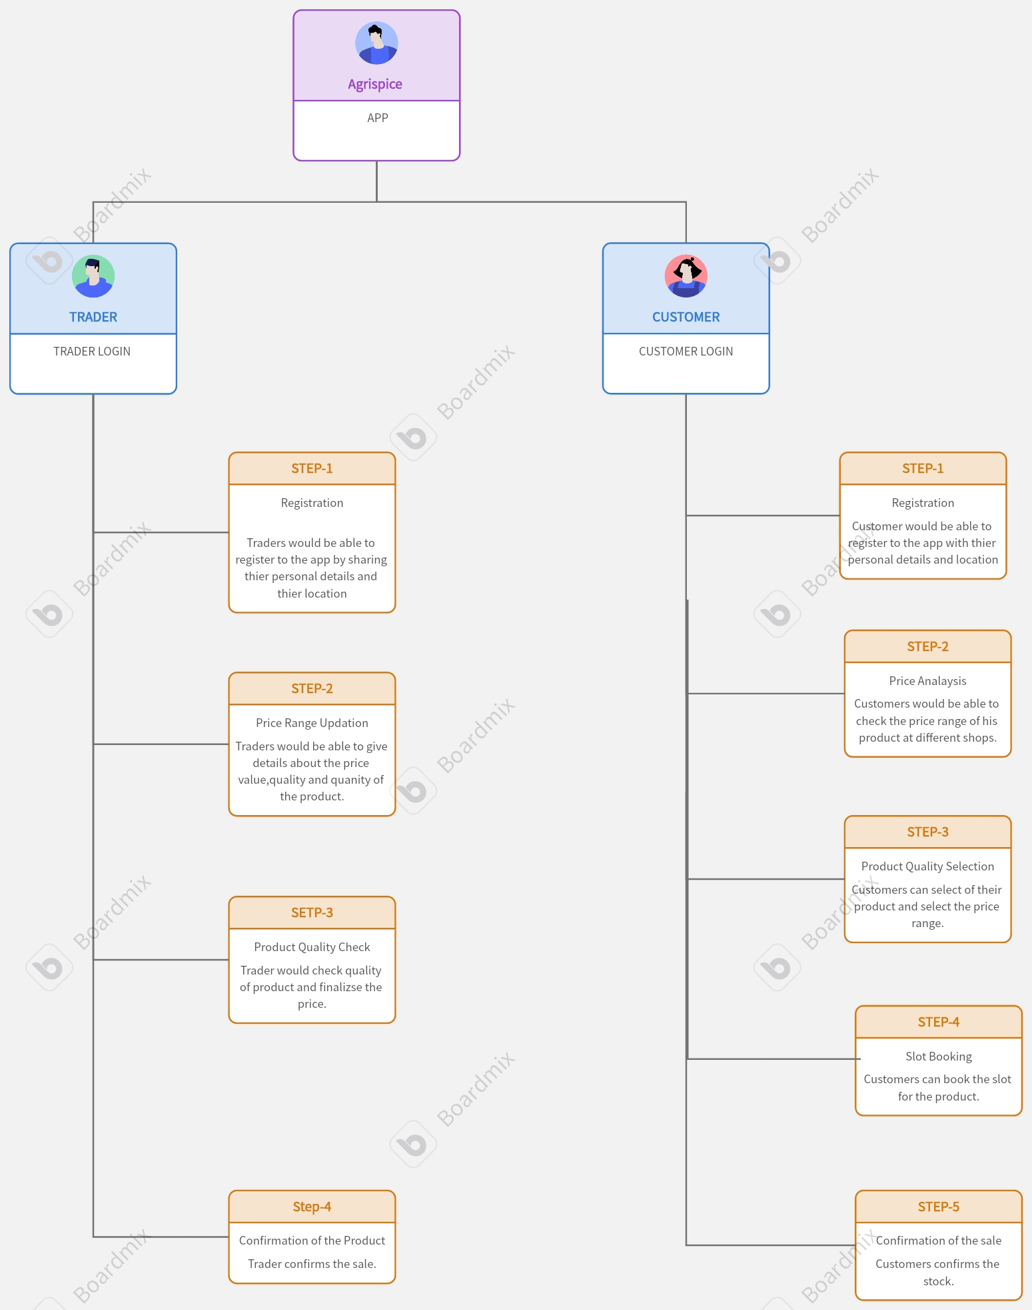
Provide a high-level architecture diagram or a use-case diagram of your proposed solution

Slide 13

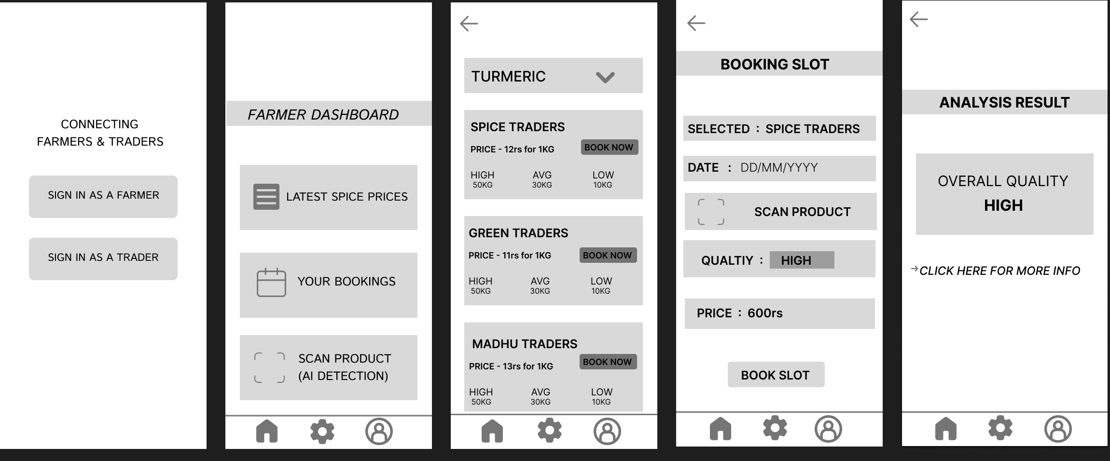
Please share the wireframes/Mock diagrams of the proposed solution (optional)
Mock Diagram For Farmer

Slide 14
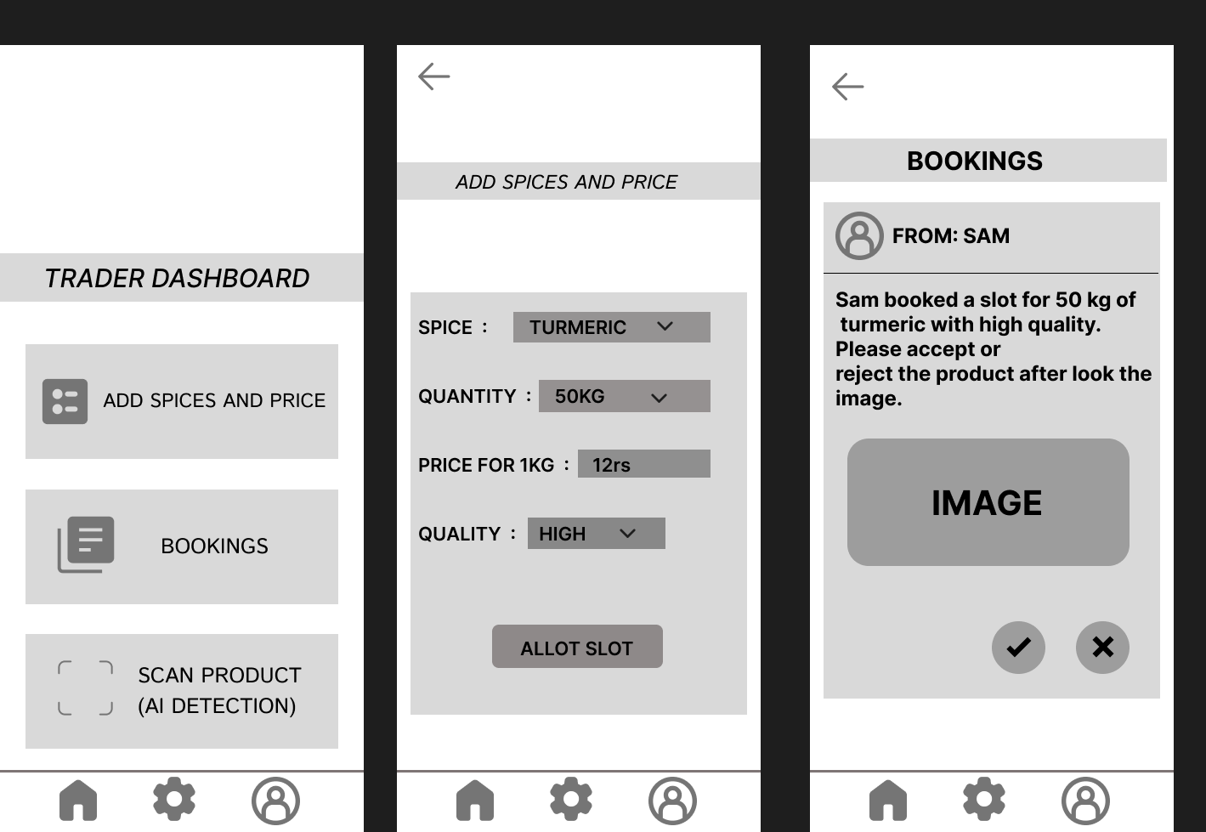
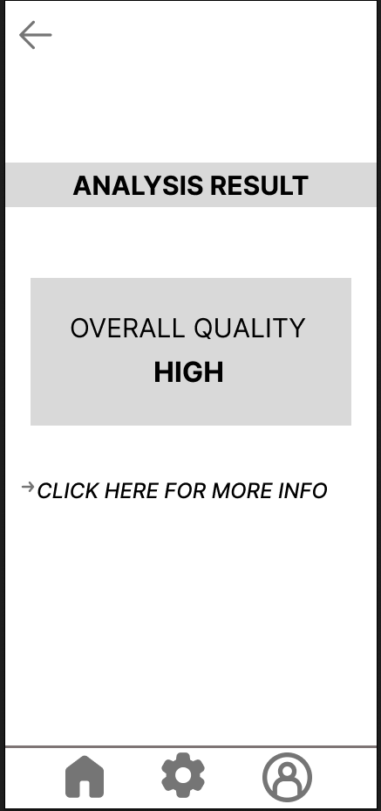
Mock Diagram For Trader

Slide 15
What datasets will your solution use? Are they publicly available, synthetic, or user-generated?
The solution will use a combination of three types of datasets:
Publicly available datasets : Government databases or APIs that provide real-time spices price updates.
User-generated data : Traders update their own prices, stock info, and shop location through the app.
Synthetic data : Used during the development and training of the AI model for price prediction , especially when real-world data is limited or inconsistent.
This combination ensures that the system remains accurate, responsive, and adaptable to real-world market conditions.

Slide 16
Does your solution require cloud-based computation, or can it work with on-device processing? If cloud-based, how do you plan to address connectivity challenges and cost constraints?
The solution uses both cloud-based and on-device processing:
Cloud-based : Required for syncing data, AI-based price prediction, user authentication, and maintaining a central database.
On-device : Stores the most recent price data locally, allowing farmers to access the app offline in areas with poor or no internet.
To deal with connectivity challenges, the app includes a local caching system, ensuring usability even when offline. For cost constraints, the app will be hosted using budget-friendly cloud services such as Firebase, AWS Free Tier, or Google Cloud for Startups, which offer reliable services at low or no cost during early stages.

Slide 17


